Slide 1
Front-End Bootcamp
Learn to build modern websites with:
HTML → Structure
CSS → Styling
JavaScript → Interactivity
Welcome 🎉

Slide 2
About Your Instructor 👨‍🏫
Name: Lahcen Nidhal Background: Software Developer & infoSec student
Experience: more then 3 years with software dev
Passion: Teaching & helping students become front-end developers

Slide 3
What We’ll Cover in This Bootcamp 🚀
Part 1: HTML
Part 2: CSS
Part 3: JavaScript
Projects after each module
Final capstone project

Slide 4
The Internet: How It Works 🌍
Internet = Global network of computers.
Works with:
Client (browser) → sends request.
Server → responds with data.
Uses HTTP/HTTPS protocol.
Example:
You type www.google.com → Browser asks server → Server sends back HTML page → Browser renders it.

Slide 5
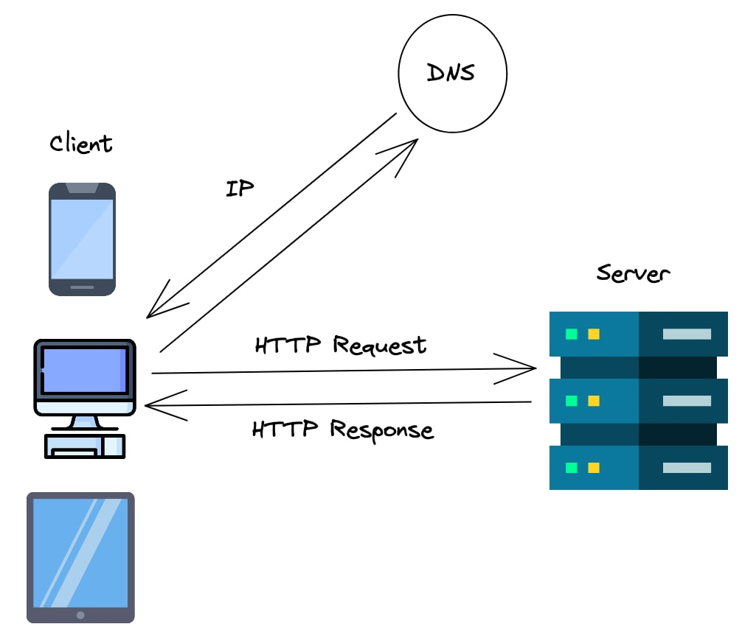

Slide 6
what is HTML? 📄
HyperText Markup Language
Defines the structure of a webpage.
Not a programming language → a markup language.
Core of every website.

Slide 7
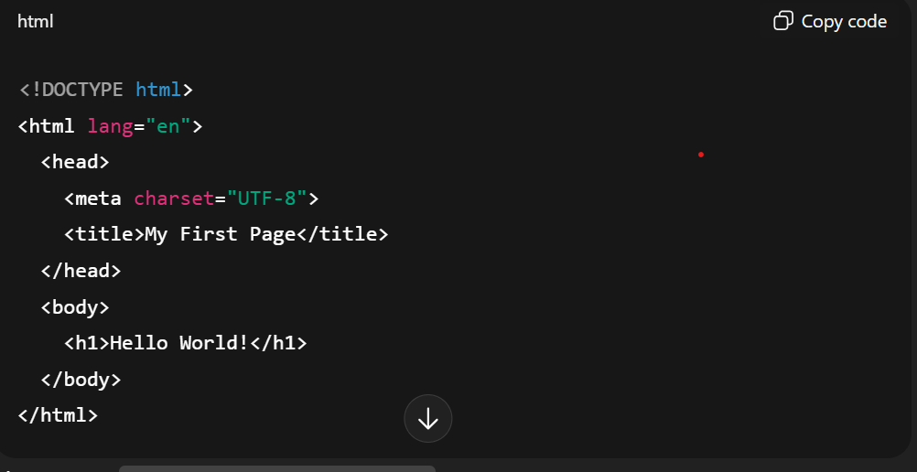
HTML Document Structure & Syntax
Every HTML document starts with:

Slide 8
Essential HTML Tags & Elements
Headings: <h1> to <h6>
Paragraphs: <p>
Text formatting: <strong>, <em>, <mark>
Lists: <ul>, <ol>, <li>
Div & Span: generic containers

Slide 9
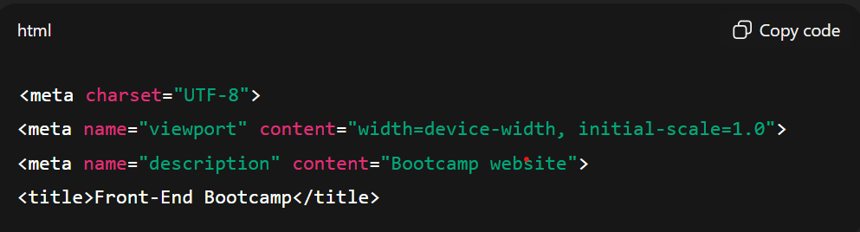
Document Head & Meta Tags
Contains information about the document.
Examples:

Slide 10
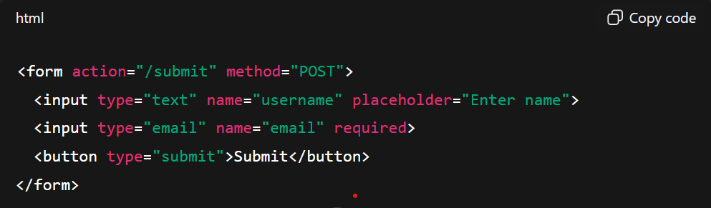
Forms & Input Types
Form basics:
Common input types: text, password, email, number, date, file, checkbox, radio, range, color.

Slide 11
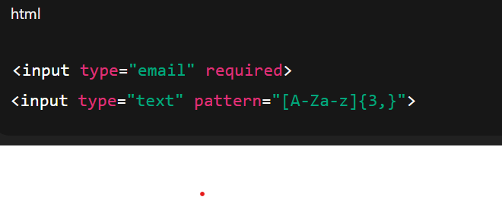
Form Validation Attributes
Built-in attributes:
required → field must be filled.
min, max, maxlength
pattern → regex validation.
Example:

Slide 12
Semantic HTML5 Elements
Meaningful tags → Improve readability & SEO.
Examples:
<header> → page header
<nav> → navigation links
<main> → main content
<article> → independent content
<section> → grouped content
<footer> → page footer

Slide 13
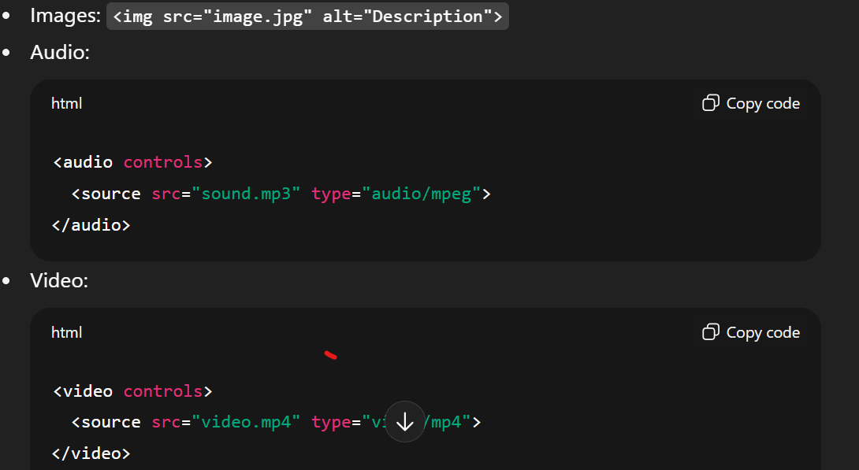
Media Elements

Slide 14
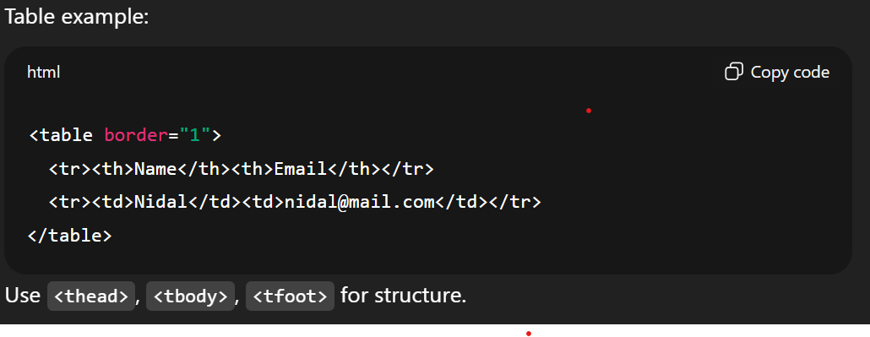
Tables & Data Presentation

Slide 15
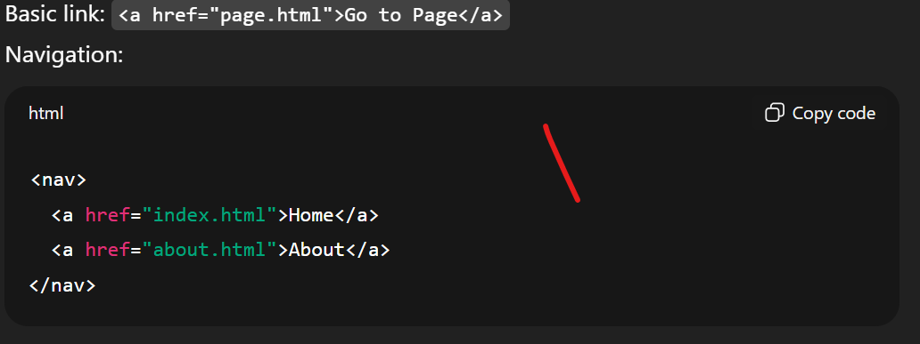
Links & Navigation

Slide 16
Project 1: Contact Form & Media Gallery
Build a contact form using:
Text, email, date, and file inputs.
Validation attributes.
Add a media gallery with images, audio, and video.

Slide 17
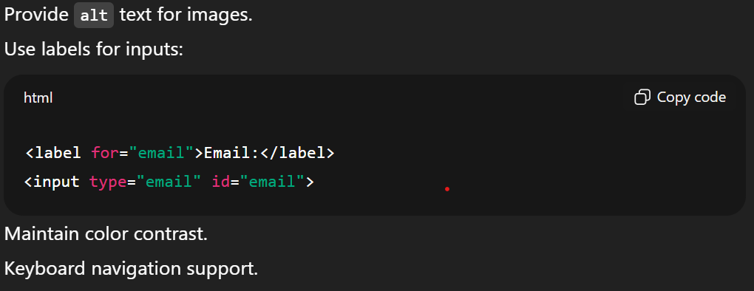
Accessibility Best Practices

Slide 18
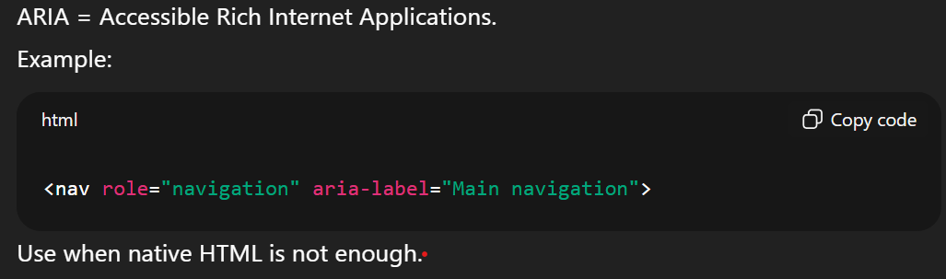
ARIA Attributes & Roles

Slide 19
SEO-Friendly HTML Structure
Use semantic tags (header, main, footer).
Use <title> and <meta description>.
Proper headings hierarchy (h1 → h6).
Meaningful link text (Read more about HTML instead of Click here).

Slide 20
HTML Debugging & Troubleshooting
Use browser dev tools (Inspect → Elements).
Check console errors.
Validate with W3C.
Common mistakes:
Missing closing tags.
Wrong nesting (e.g., <p><div>...</p></div>).

Slide 21
Project 2: Accessible Multi-Page Website
Create a multi-page site with:
Navigation (<nav>).
Semantic layout (header, main, footer).
Accessibility features (labels, ARIA).
SEO best practices.

